Slide 1

Slide 1
US Accidents Analysis
Laury Benoit

Slide 2
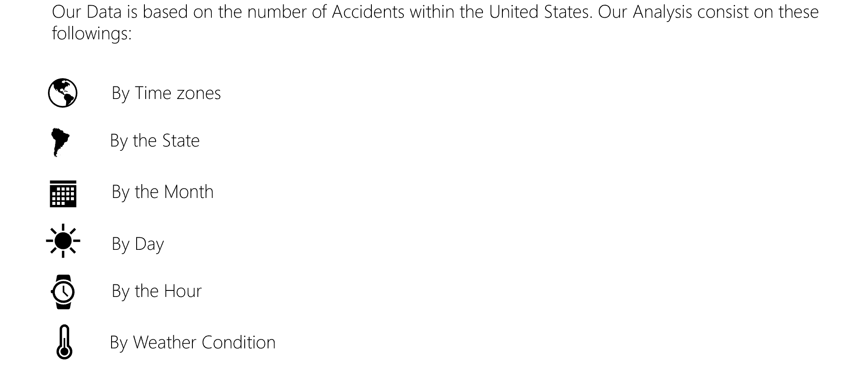
Overview

Slide 3
Data Mining
Data:
Kaggle
https://www.kaggle.com/sobhanmoosavi/us-accidents Population by Time zone(s) (2018) (Source: Wikipedia) Population by State(s) (2018) (Source: Wikipedia) Land area (sq. miles) by State(s) (2018) (Source: Wikipedia)
Cleanup process include:
Drop columns not being used for analysis Drop rows with all columns na/null Drop rows that have na/null value for the columns being analyzed Drop rows which are less than year 2017 & greater than year 2018Additonal

Slide 4
Data Mining
Hypothesis:
Based on our data, our predictions was that major States such as California
Questions:
What are the safest areas geographically by Time zone & state? Does the pattern for counts of accidents directly correlate to severity of accidents? Is there any pattern when number of accidents are aggregated monthly? Verify most accidents are during rush hour and is the pattern consistent when viewed aggregated monthly? Is rain/snow weather a major factor to the number of accidents?

Slide 5
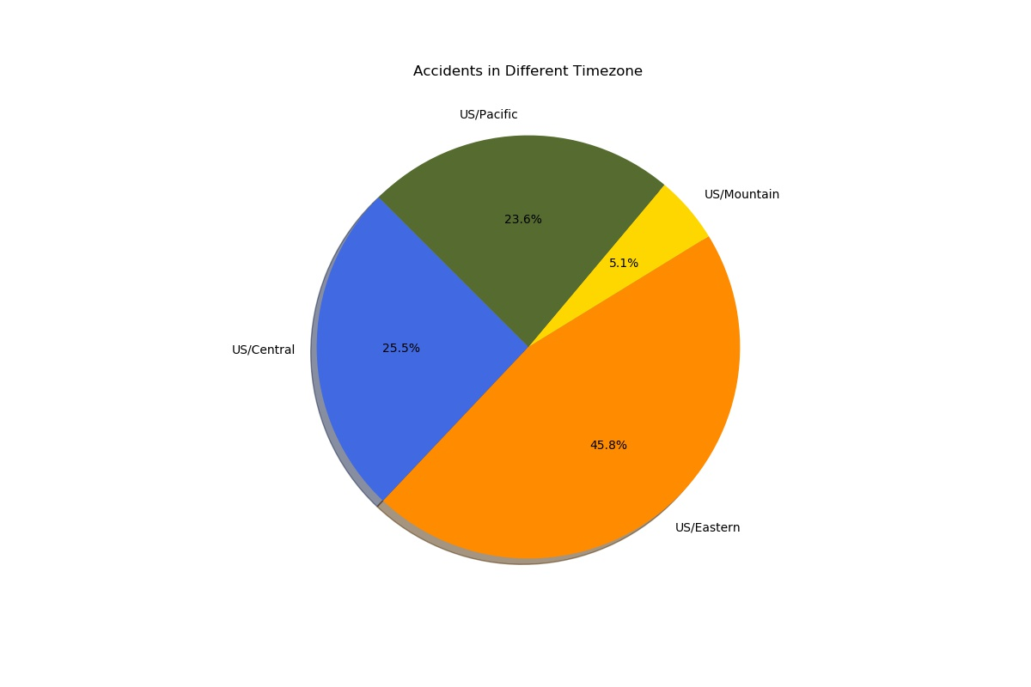
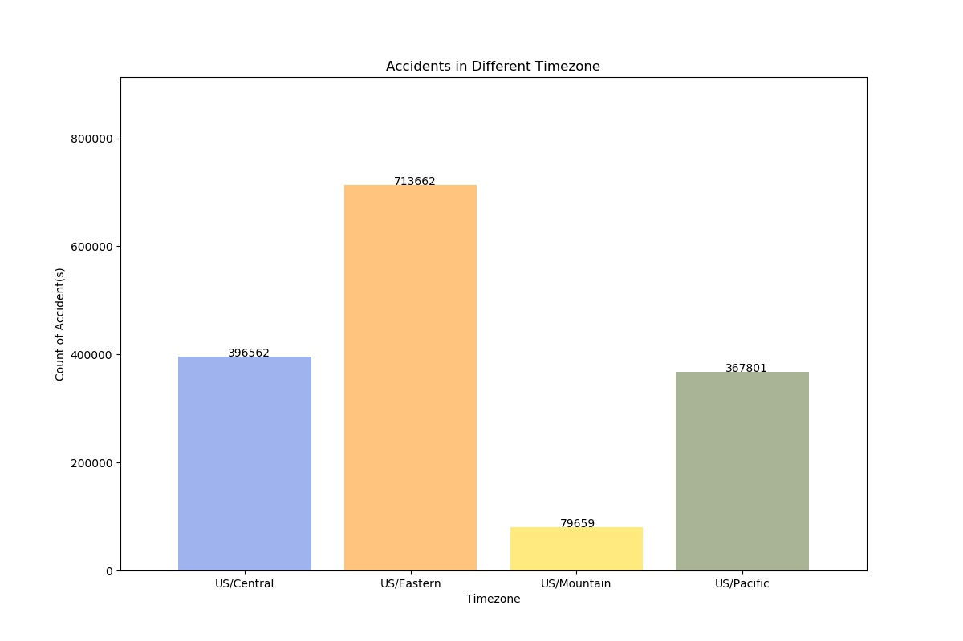
By Time Zone

Slide 6
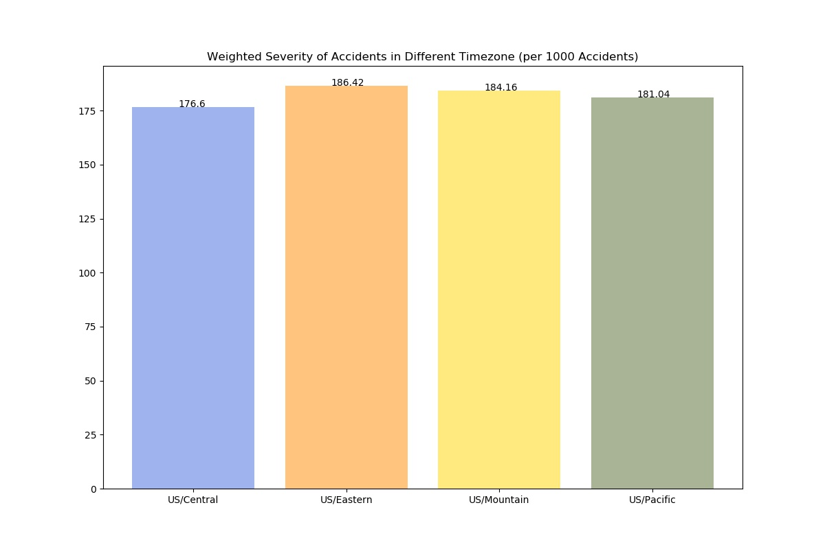
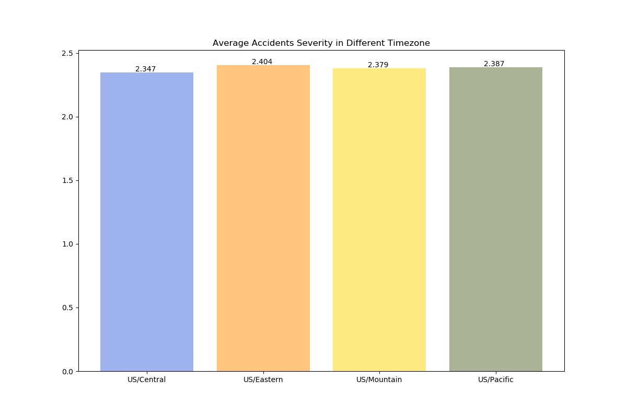
By Severity in different Time zone

Slide 7
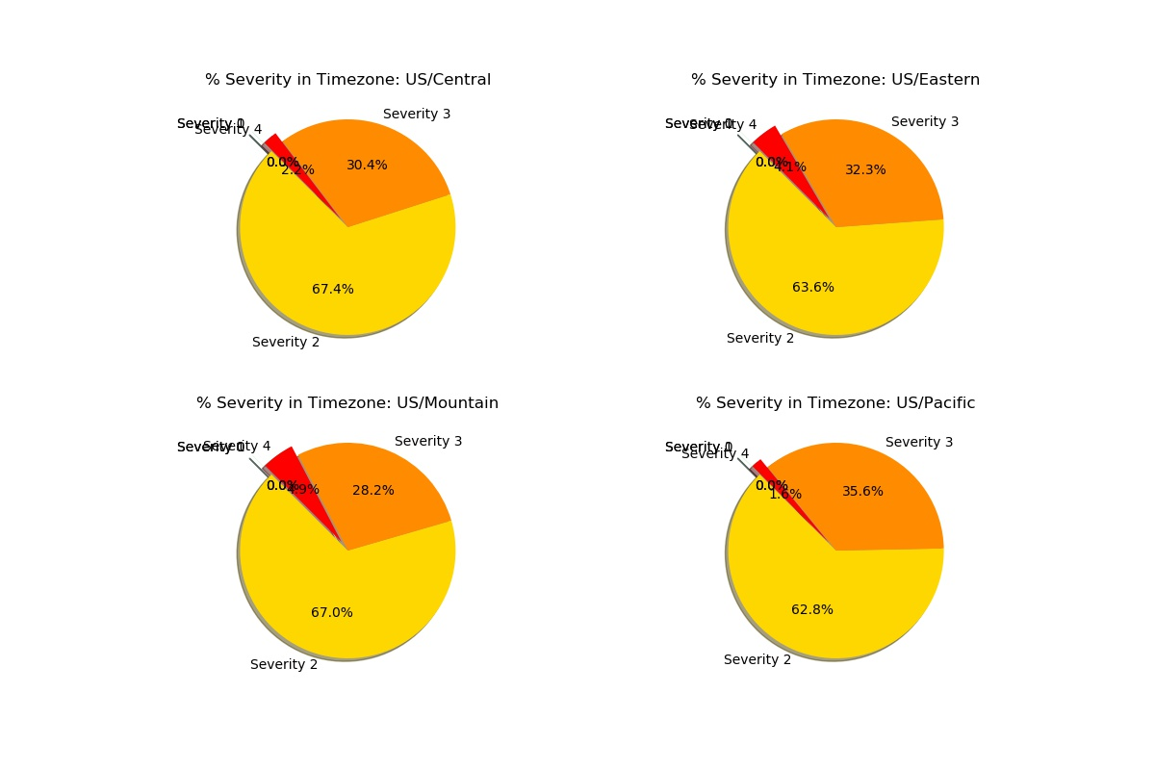
By Severity in Time Zone

Slide 8
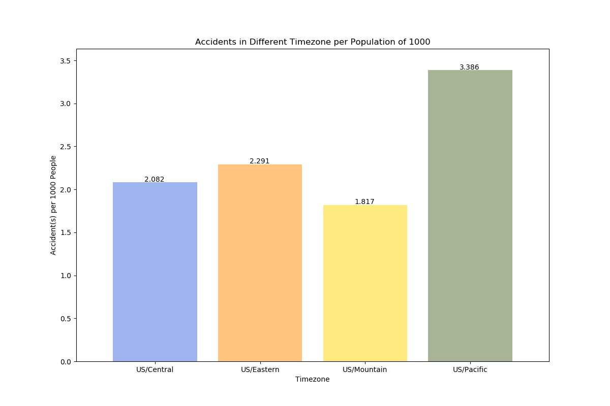
By Different Time Zone per Population of 1000

Slide 9
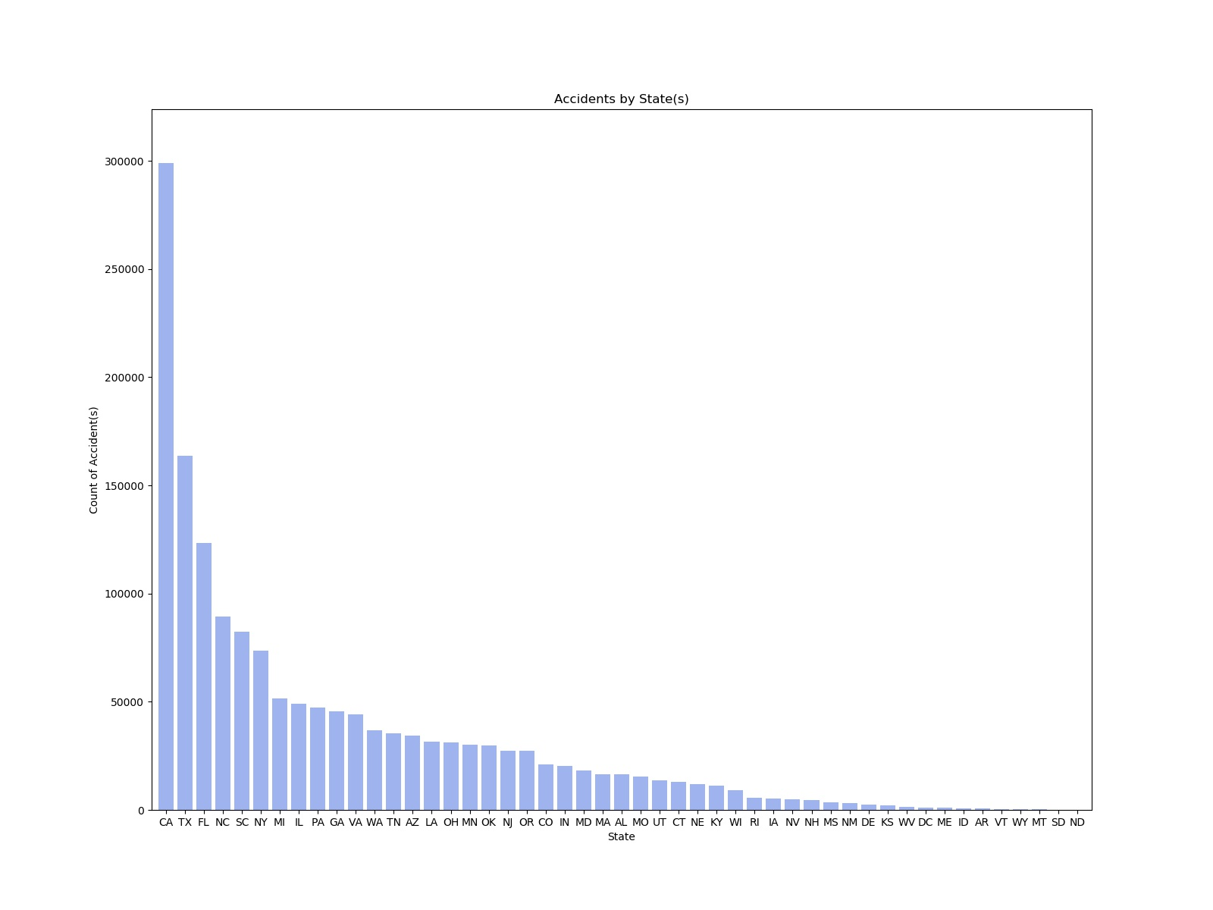
By State

Slide 10
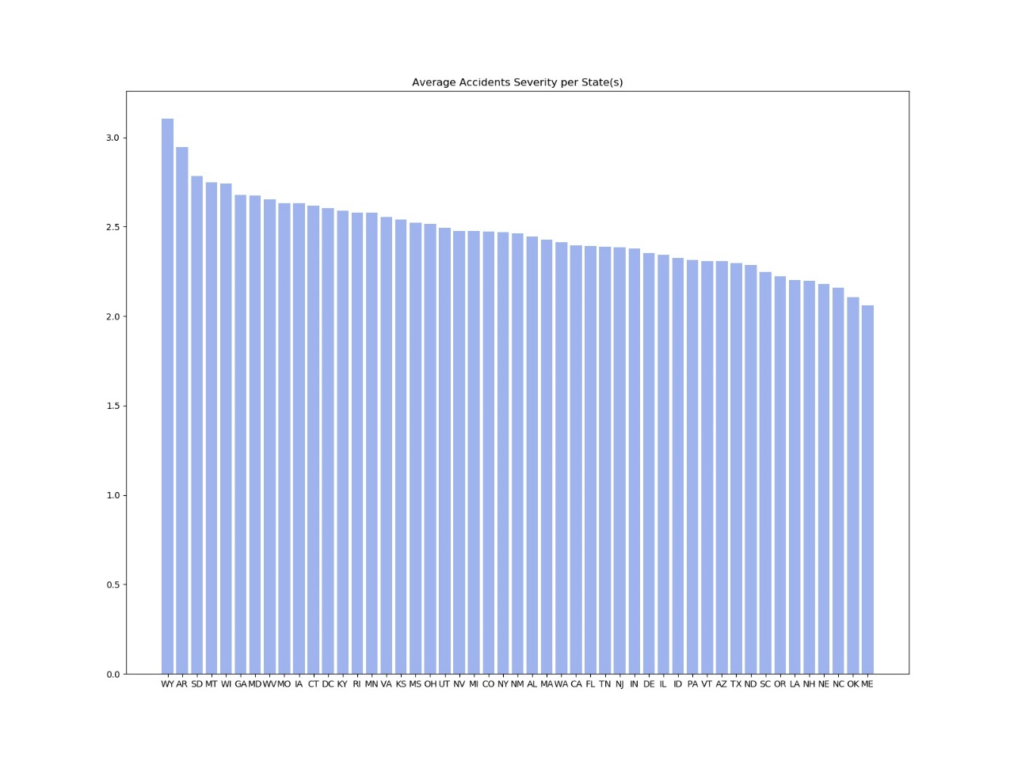
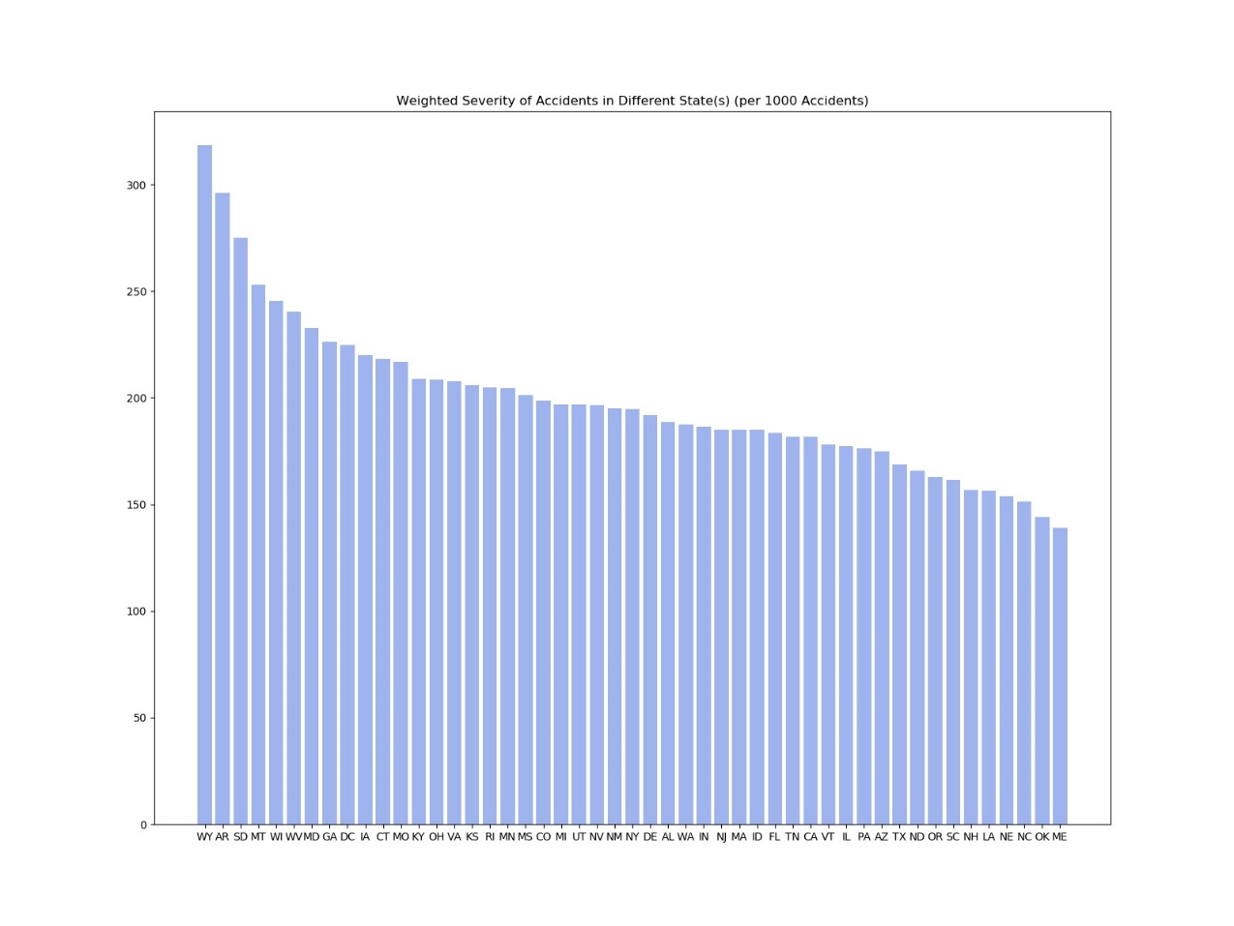
By Severity Per State

Slide 11
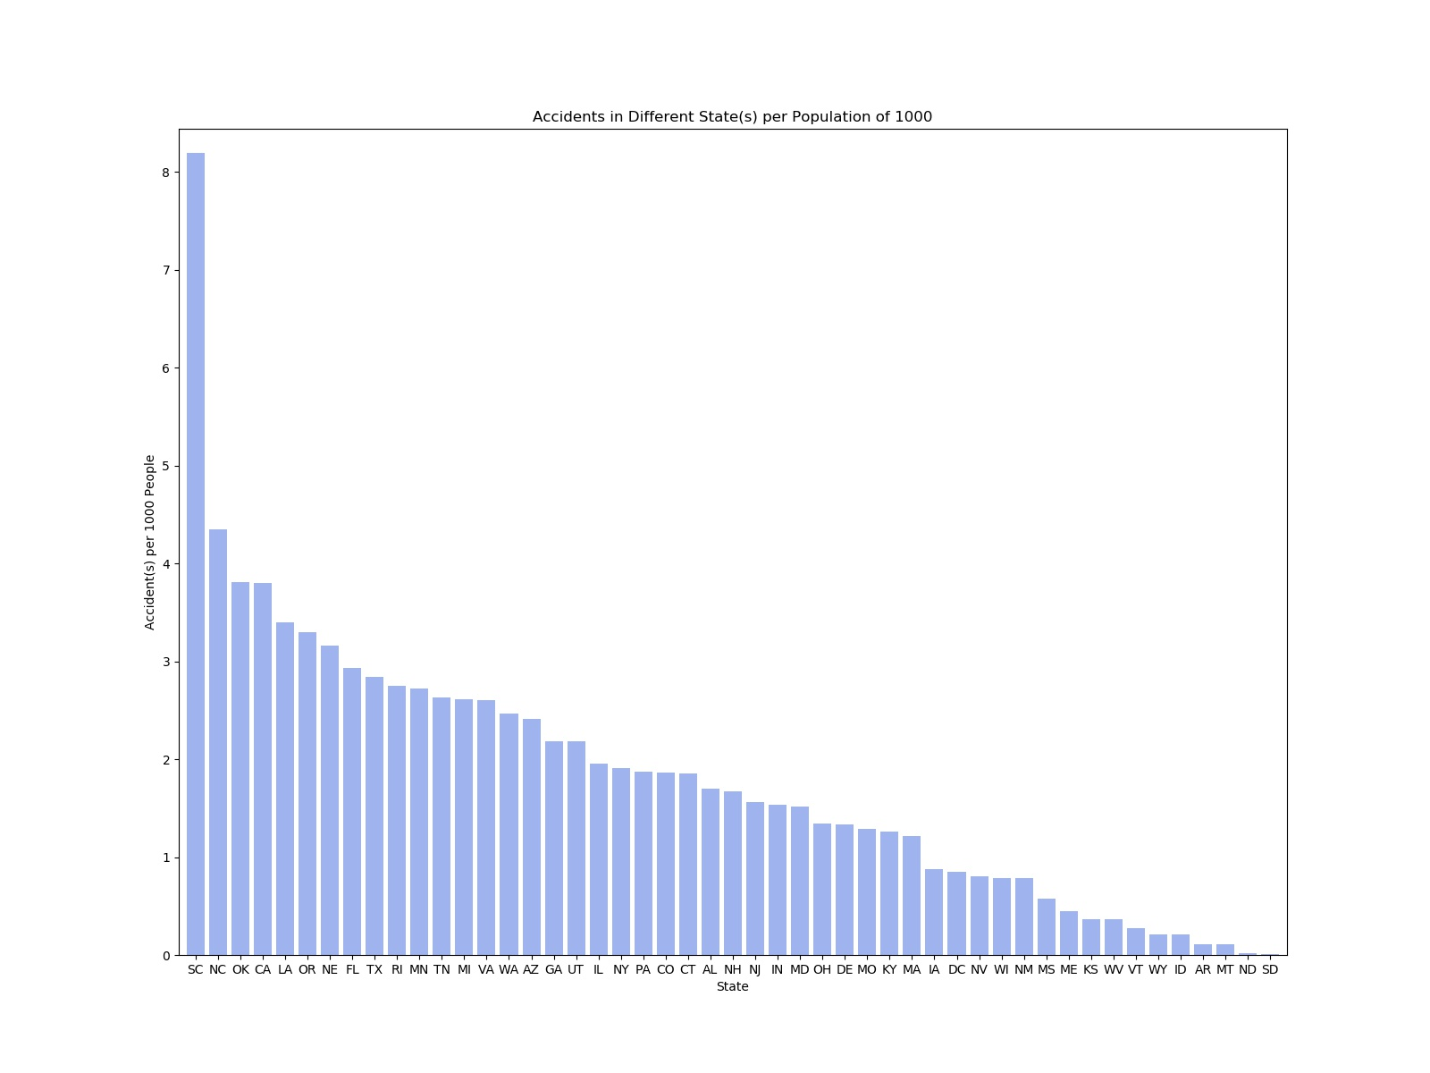
By Different States Per 1000

Slide 12
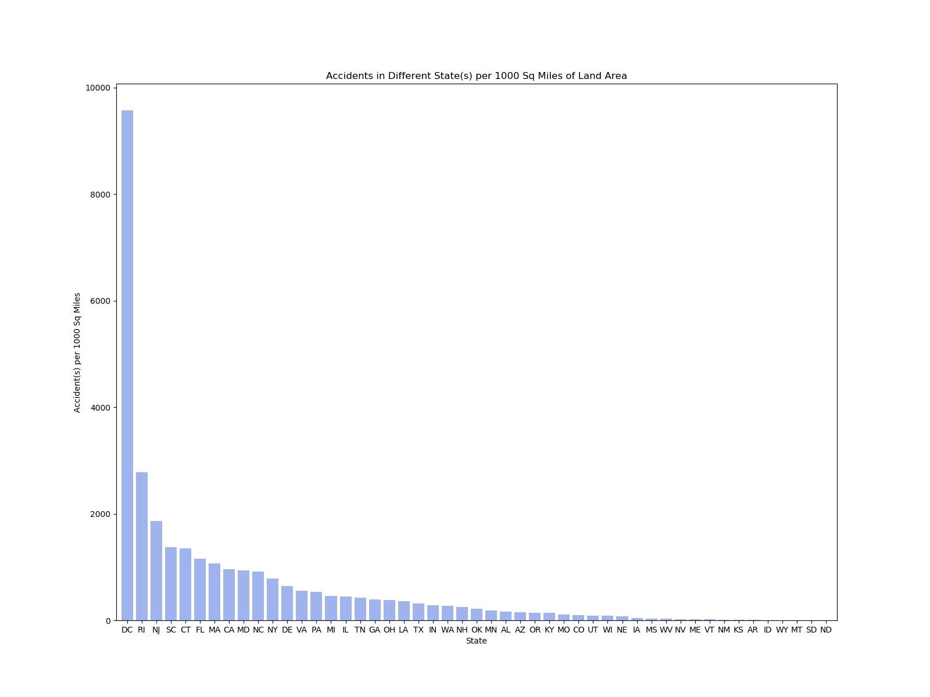
By Different States Per 1000 Sq. Miles

Slide 13
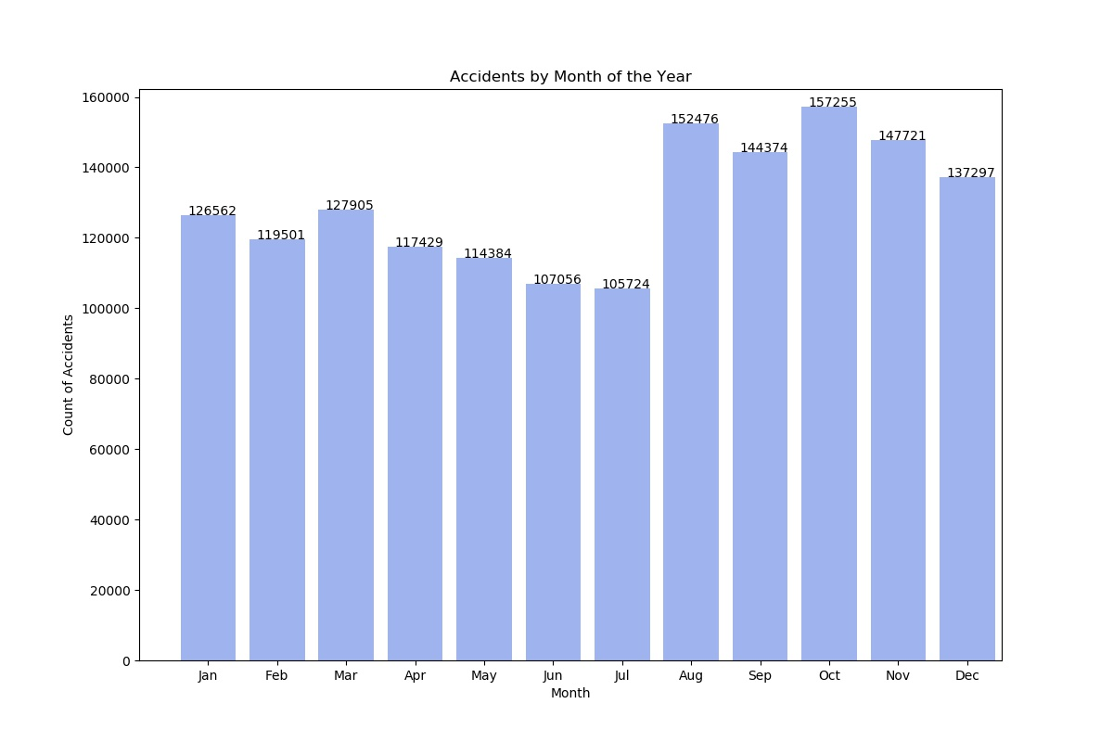
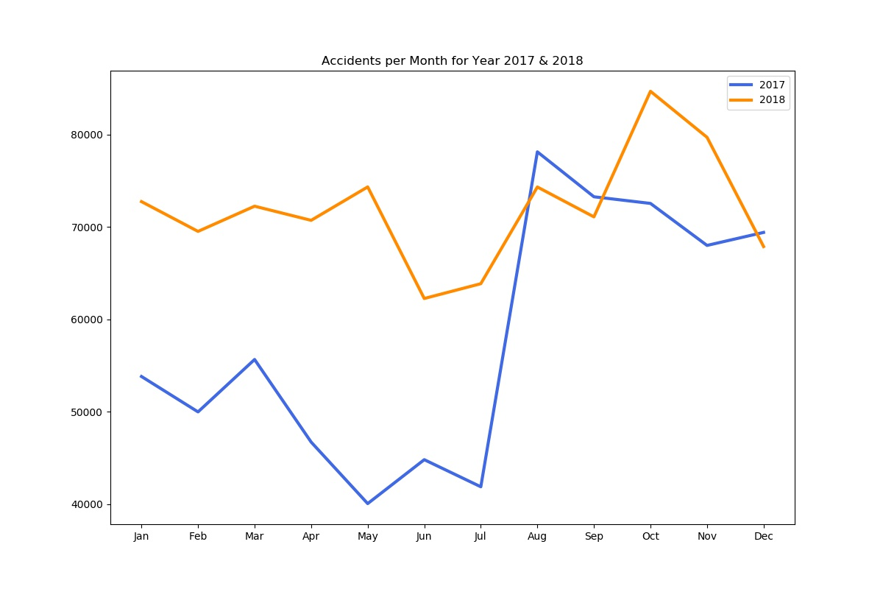
By Month

Slide 14
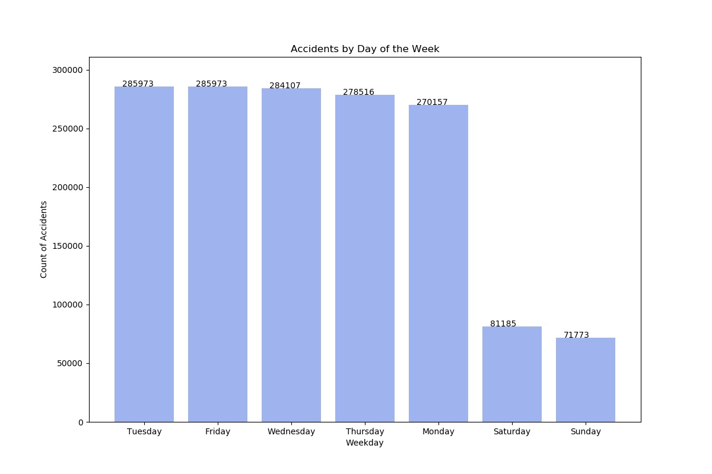
By Day

Slide 15
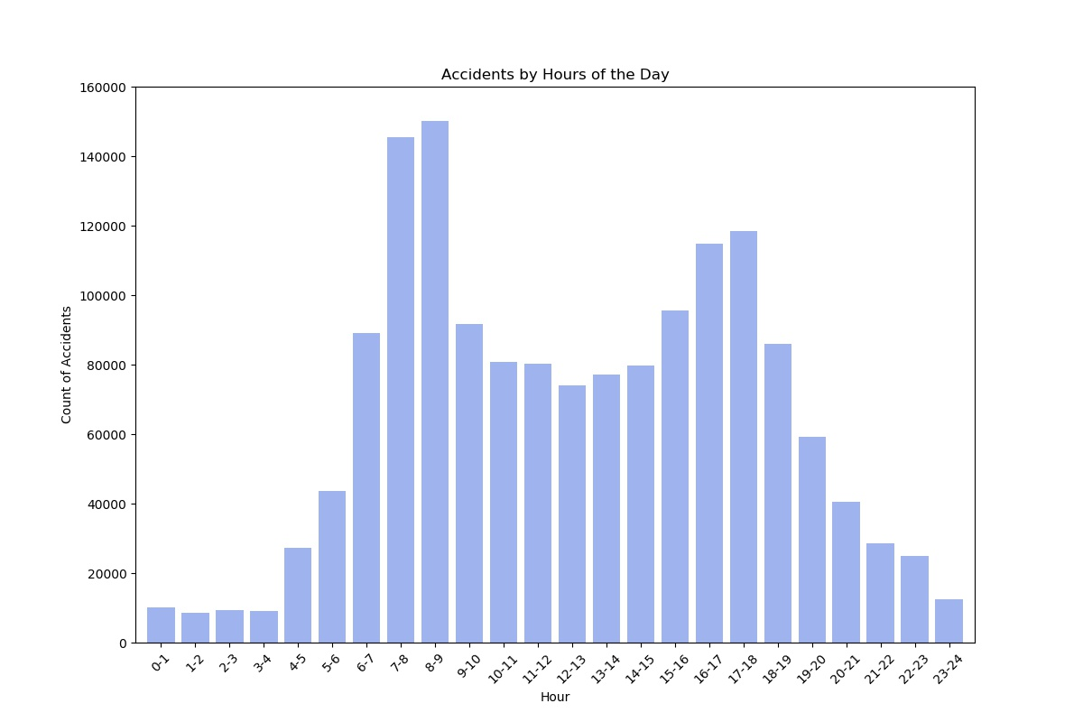
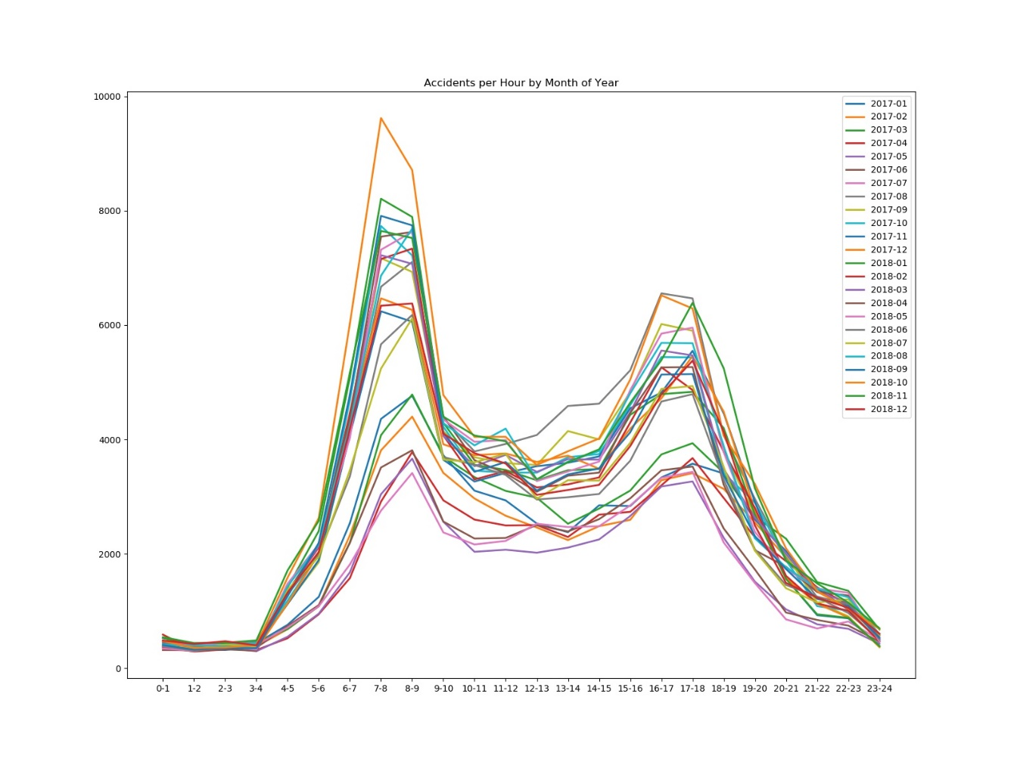
Hourly Patterns

Slide 16
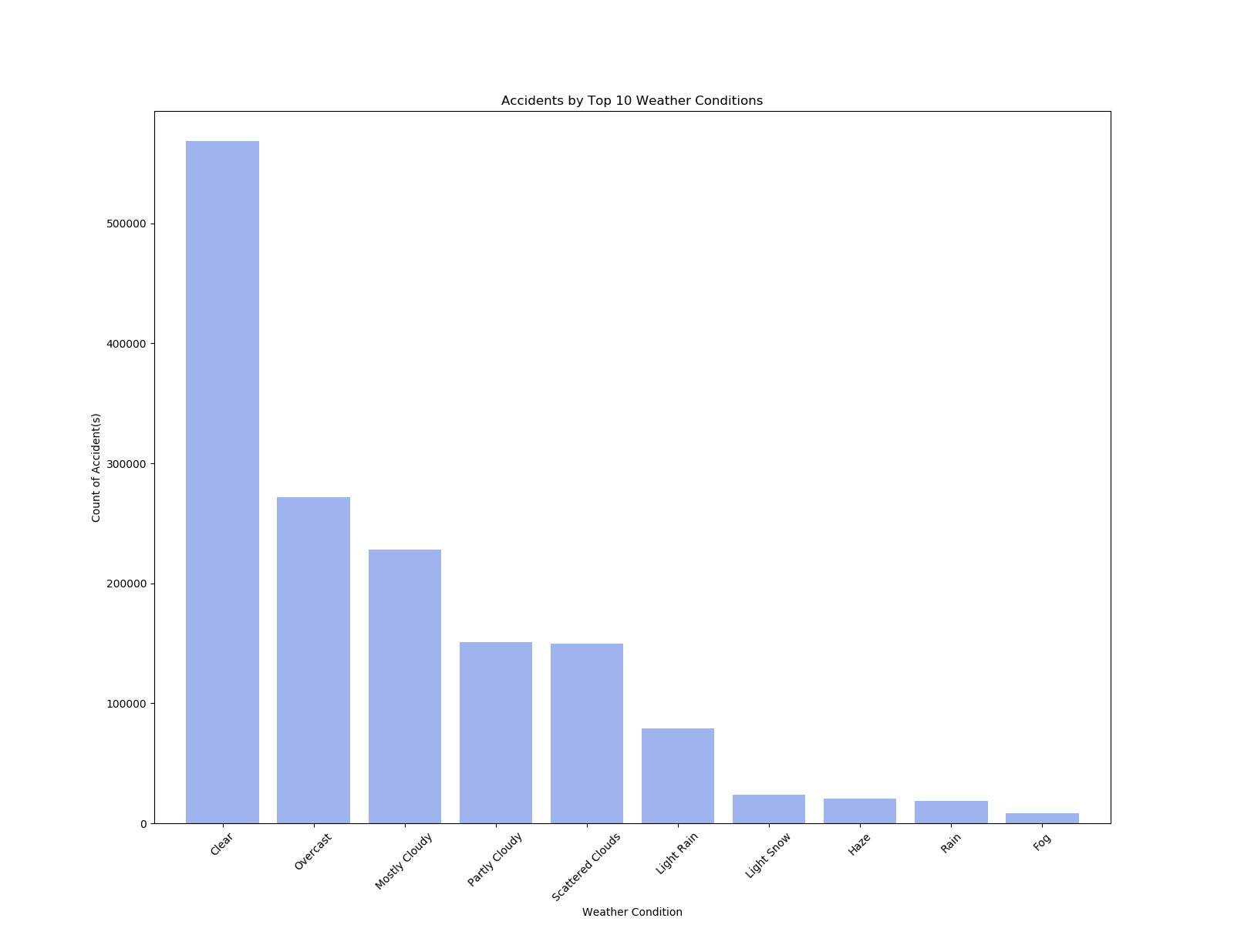
By Weather Conditions

Slide 17

Q & A

Slide 18

Slide 11
THANK YOU

